Slide 1
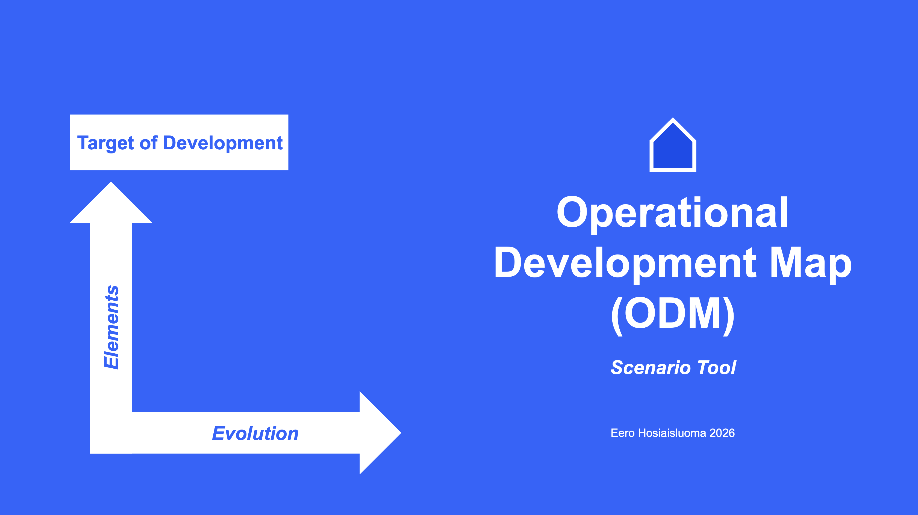

Slide 2
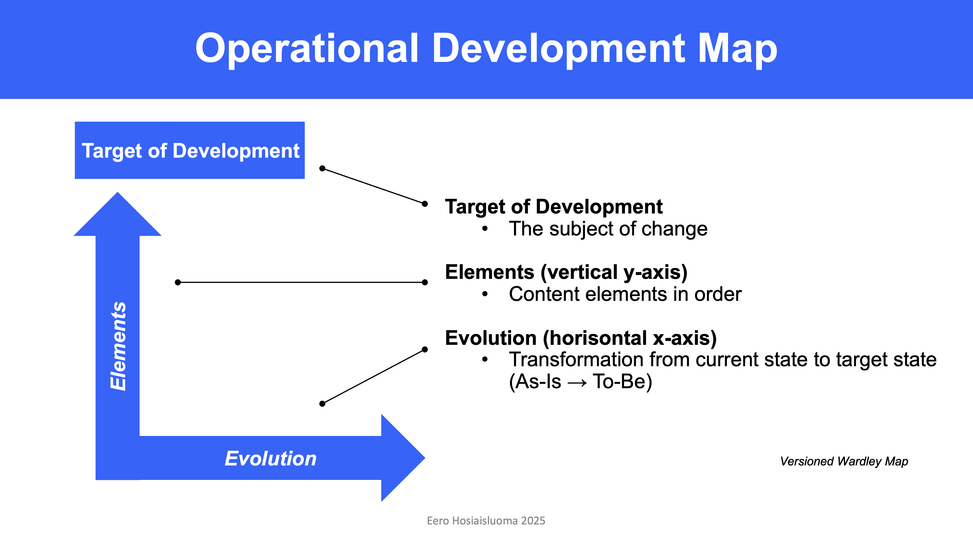

Slide 3
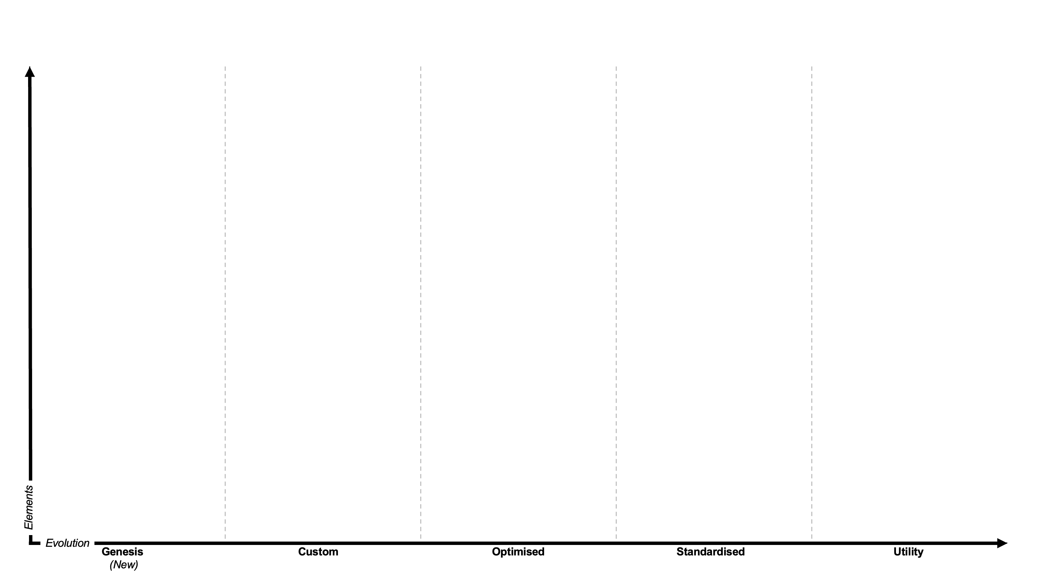
Scenario 1
Capability
Legend
As-Is
To-Be
New
Development
To Be Removed
Role
Process
Lean
Process
Development
Data
Application
procurement
Application
SaaS

Slide 4
Product / Service
Legend
Customer Group
As-Is
To-Be
New
Development
To Be Removed
Role
Process
Lean
Process
Development
Data
Application
procurement
Application
SaaS

Slide 6
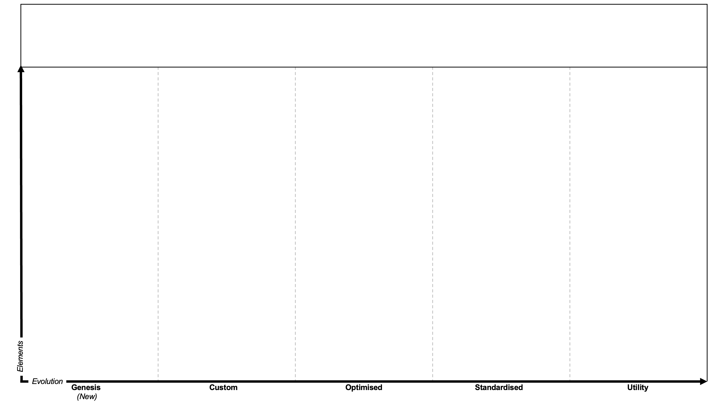
Target of Development
Capability
Role
Process
Asset
Application

Slide 7
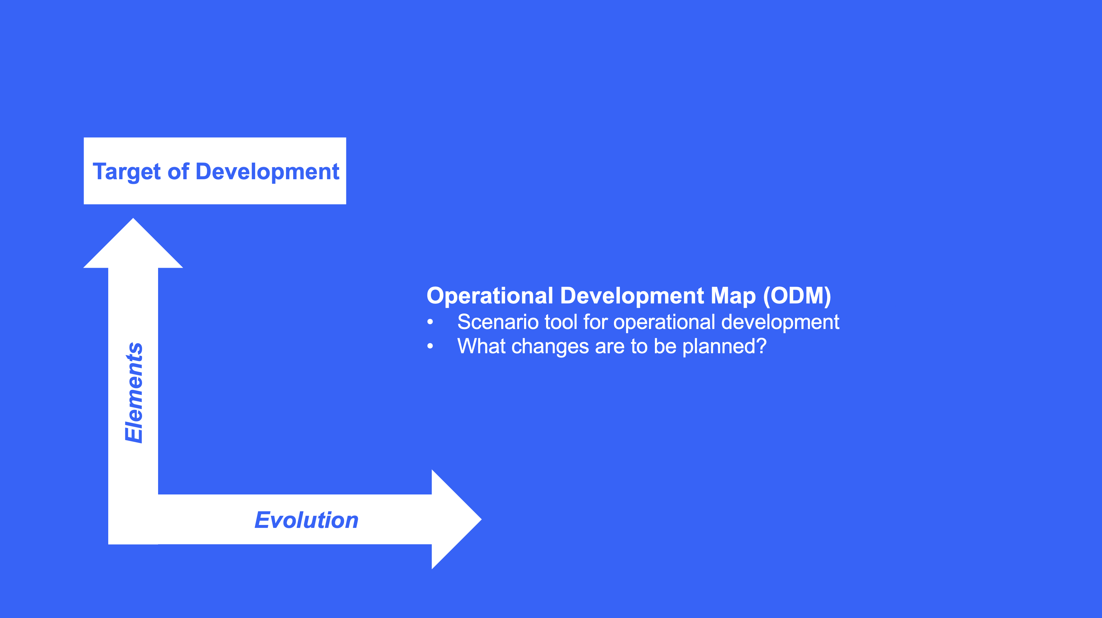

Slide 8
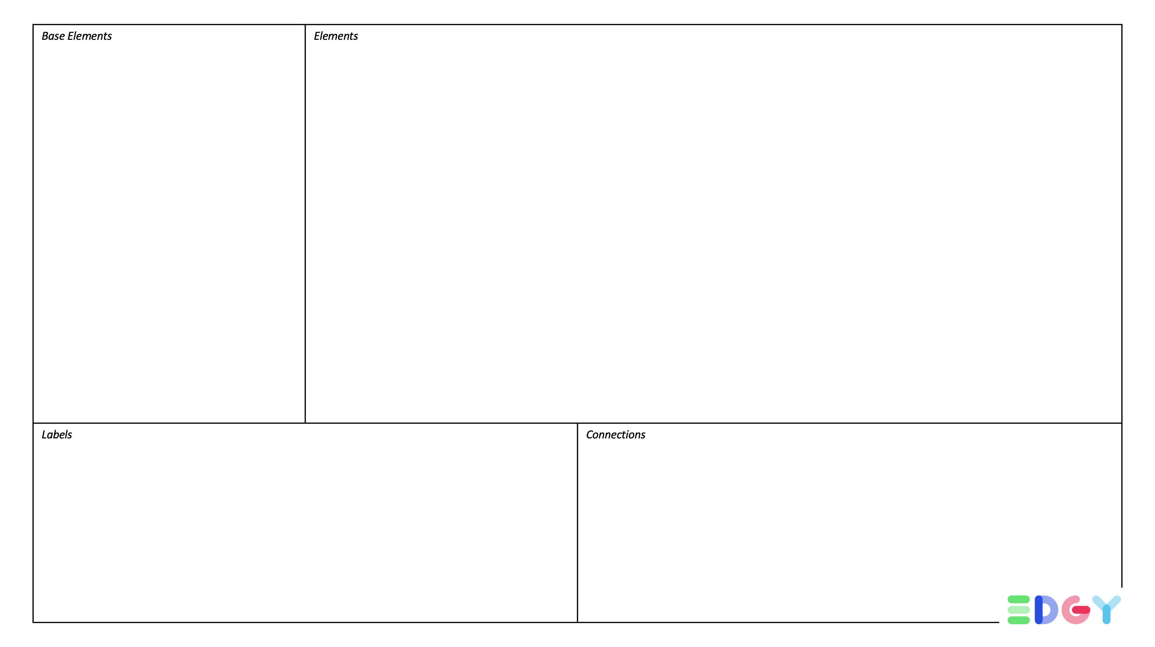
Outcome
Purpose
Task
Capability
Object
Content
Brand
Channel
Product / Service
Asset
Organisation
People
Activity
Story
Journey
Process
Team
Legend
Legend
Legend
Application
Link (Association)
Tag / Metric
Technology
Tag / Metric
Tag / Metric
Tag / Metric
Tag / Metric
Data
Tag / Metric
Flow
data
Metric
Metric
Metric
Device
Tag / Metric
Metric
Metric
Metric
Facility / Location
Tag / Metric
Metric
Metric
Metric
Tag / Metric

Slide 9

Material:
Enterprise Design & EDGY Cookbook
EDGY Cookbook (pdf)
Enterprise Wheel
EDGY Motivations

Slide 10
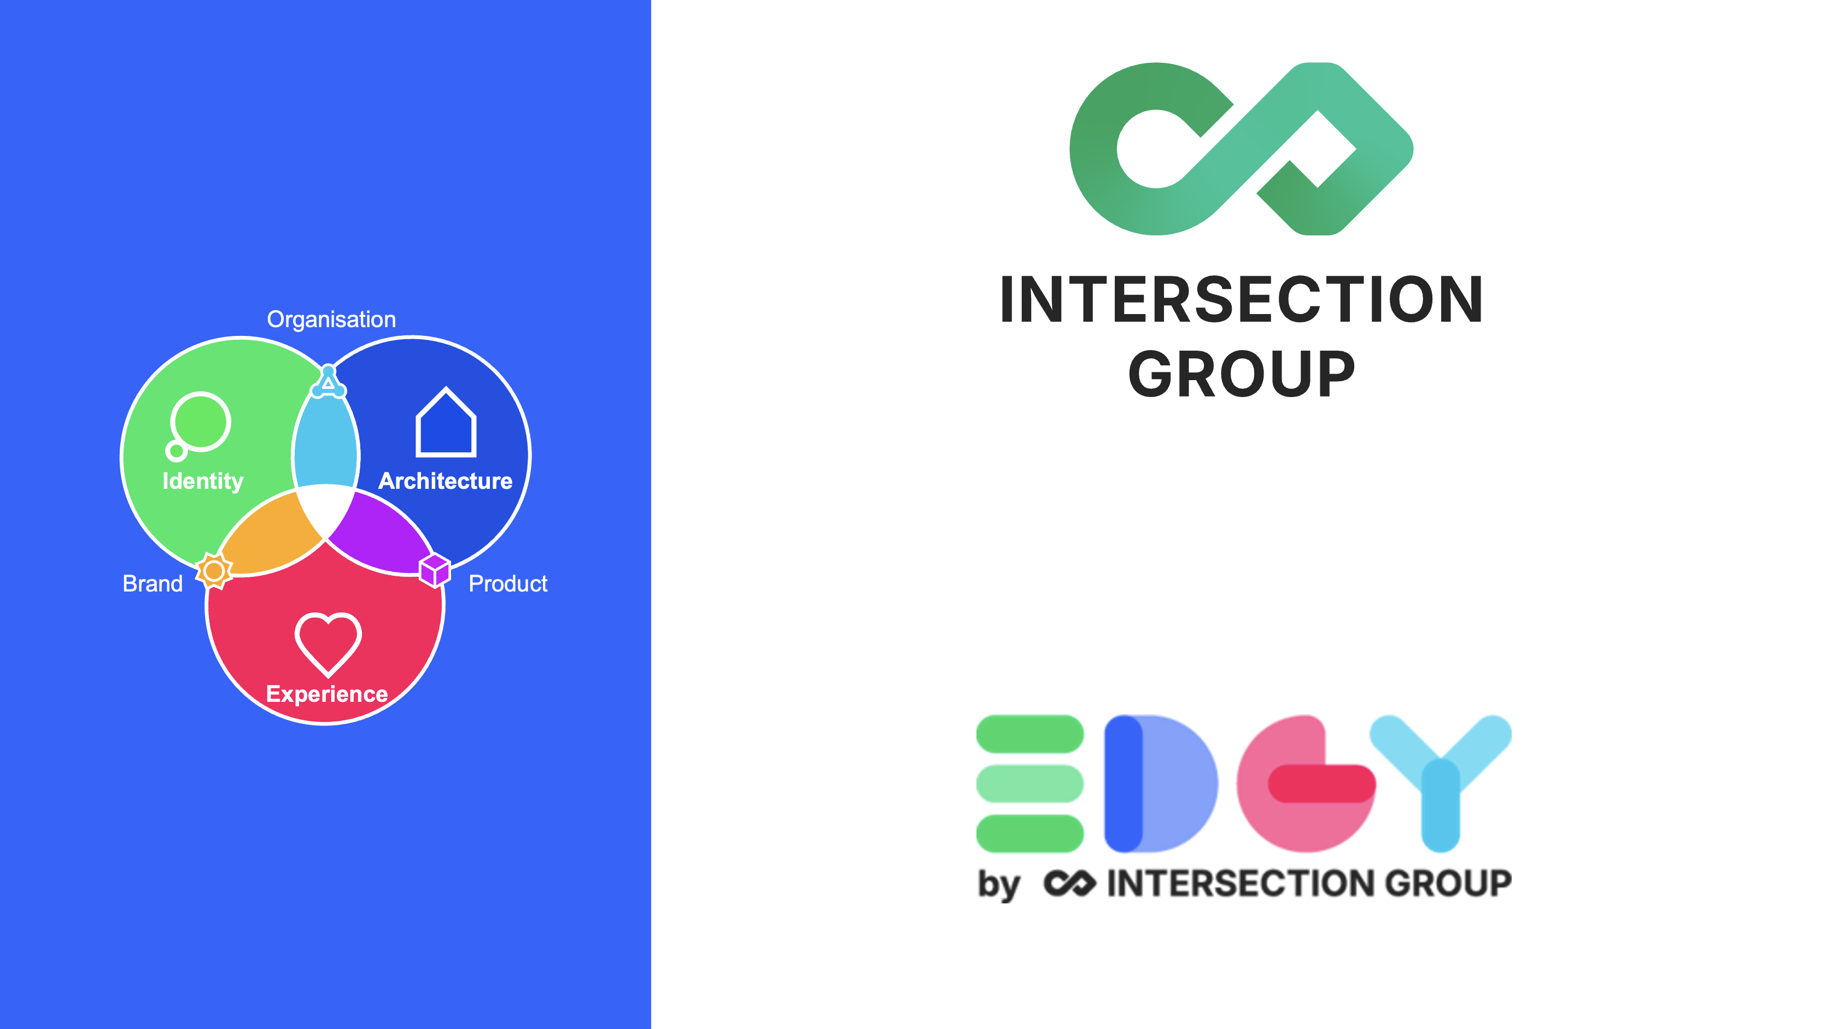
Intersection Group pages:
Enterprise Design with EDGY (open-source tool)
Intersection Group (not-for-profit organisation)

